Slide 1
Public speaking
Checkpoint

Slide 2
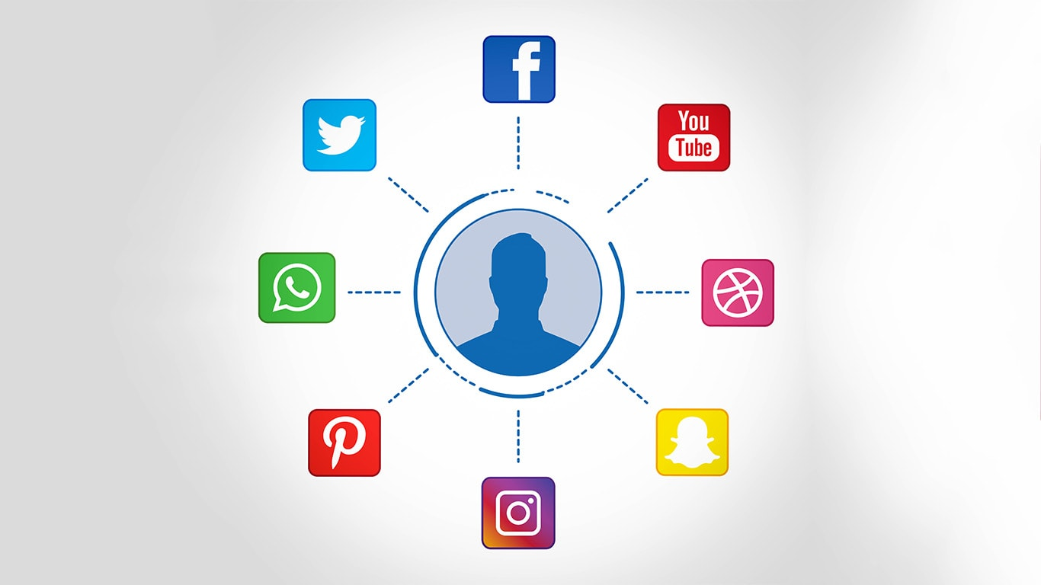
Social media networks strengthen human relationships

Slide 3
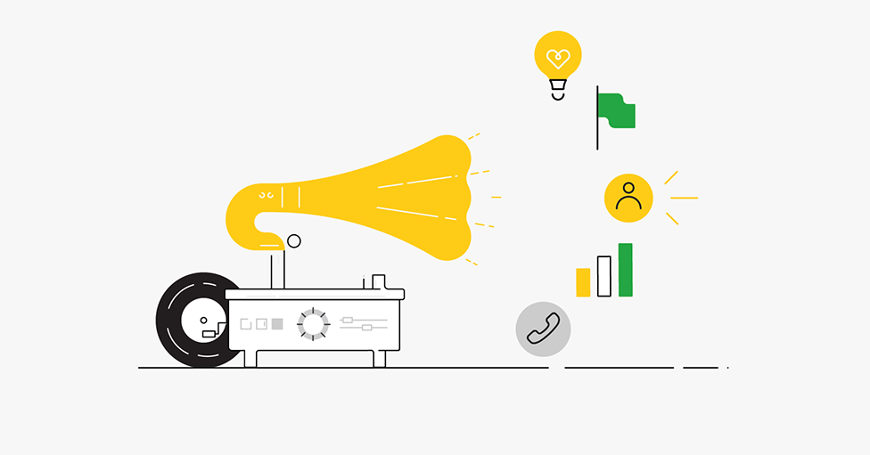
Factual arguments

Slide 4
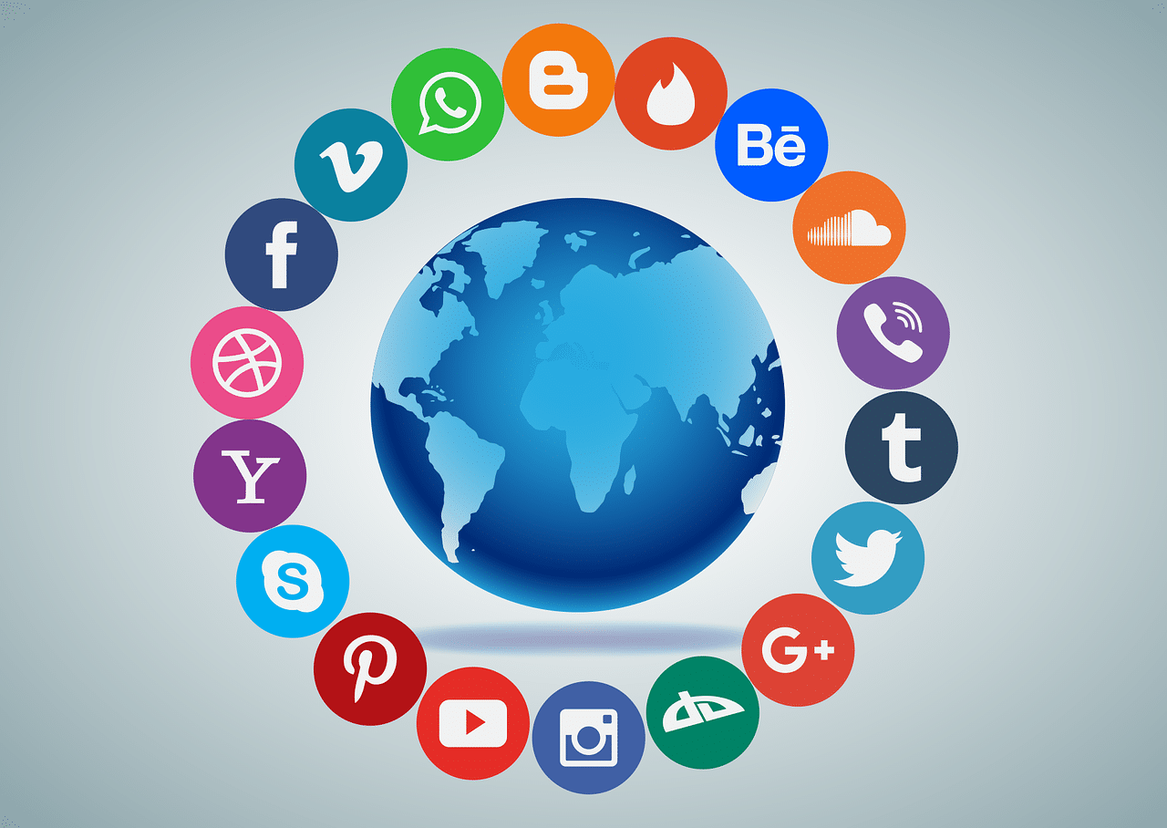
Connect the world

Slide 5
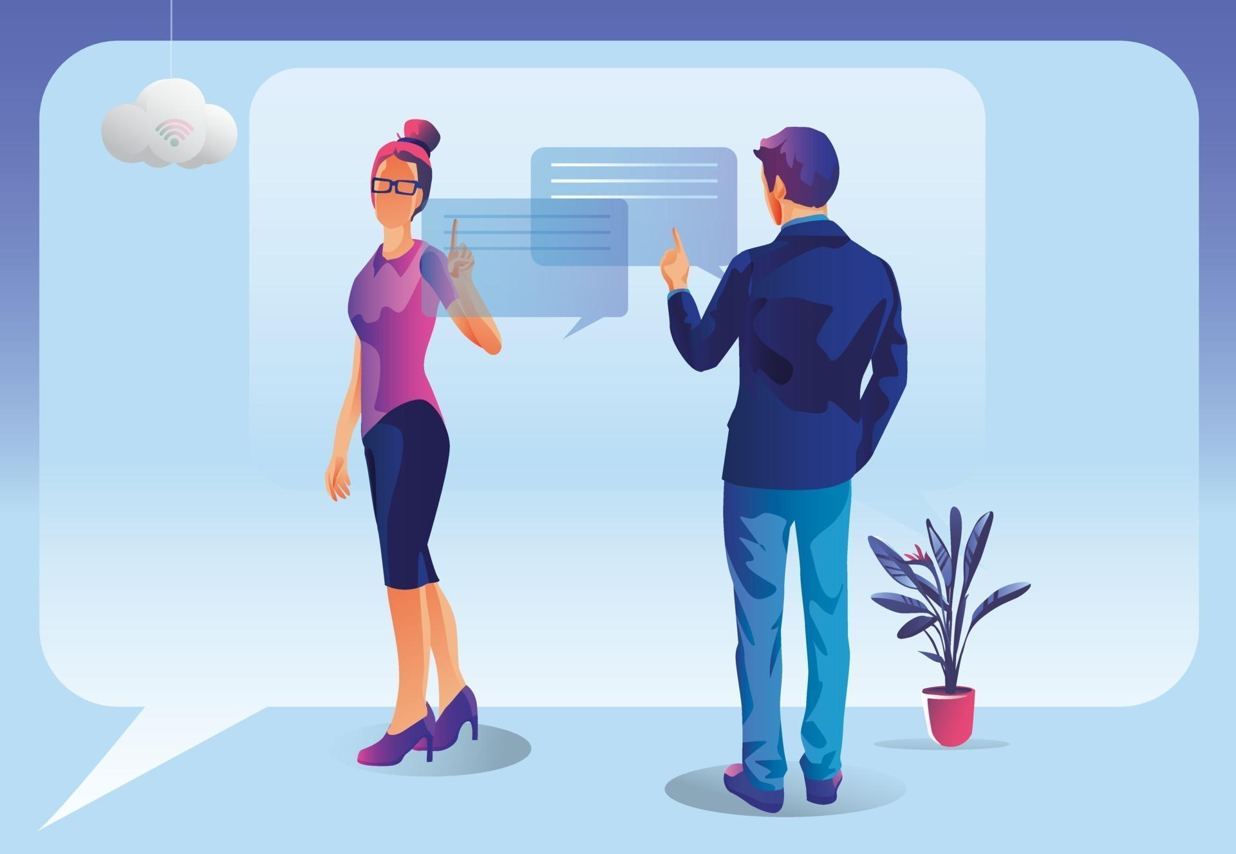
Real time talking

Slide 6
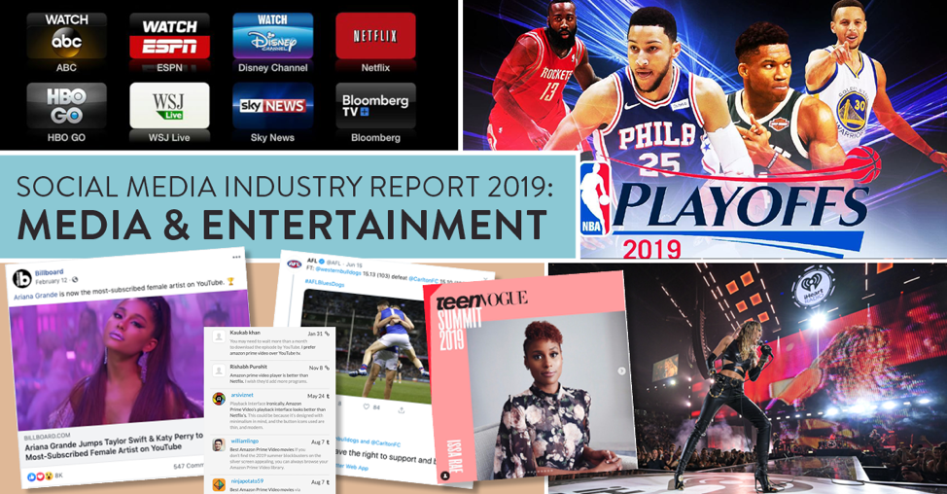
Entertainment

Slide 7

Emotional arguments

Slide 8
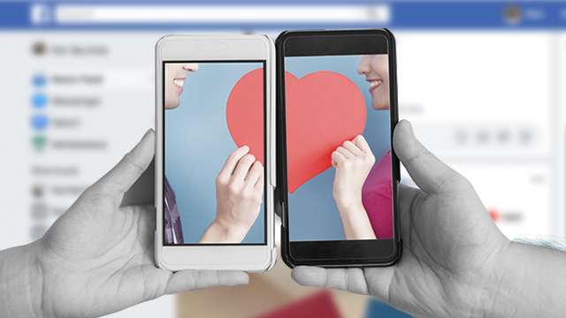
Love booster

Slide 9
Useful at work

Slide 10
Rational arguments

Slide 11
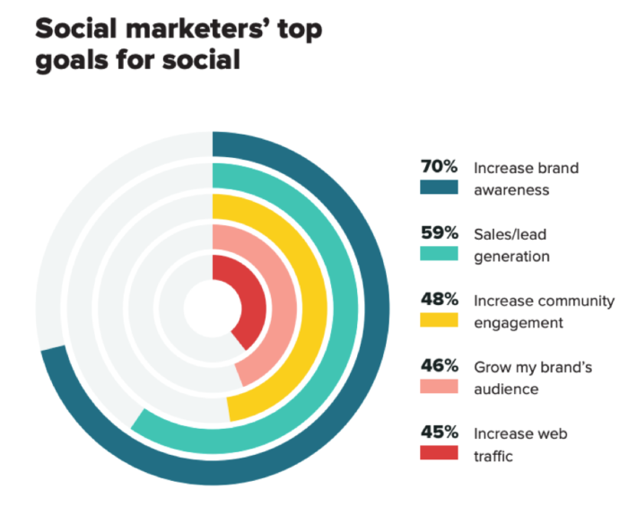
Awareness

Slide 12

Marketing

Slide 13
Thank you !

